Slide 1
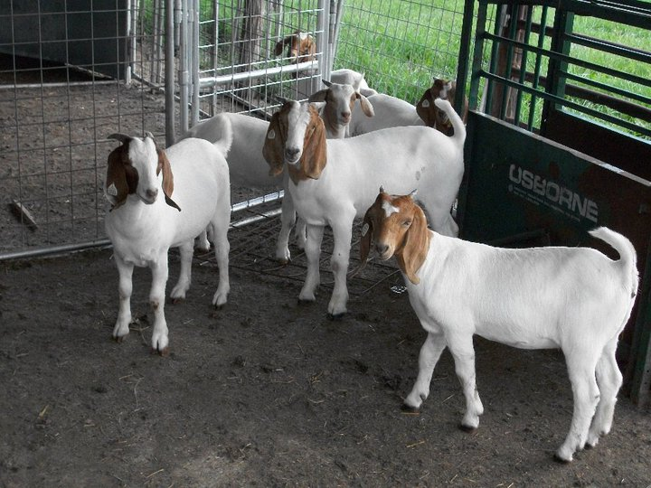
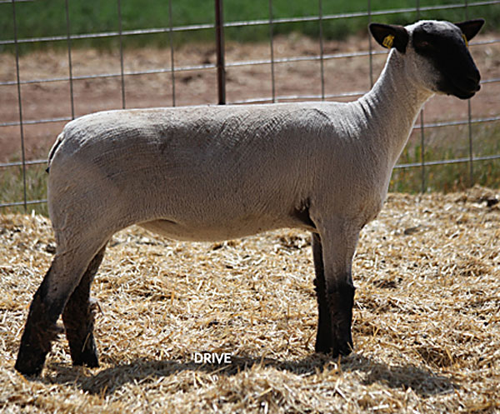
2019 Showmanship Clinic Tyrrell County Cooperative Extension
Lambs & Goats

Slide 2
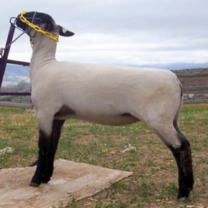
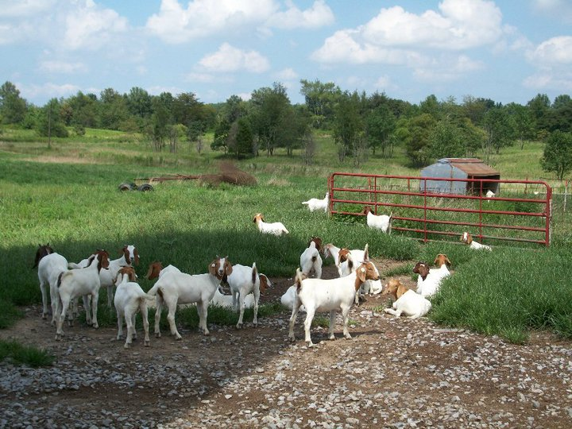
Rules for Good Health
Provide proper housing
Practice good sanitation
Provide good nutrition
Provide clean water
Observe your animal for strange behavior

Slide 3
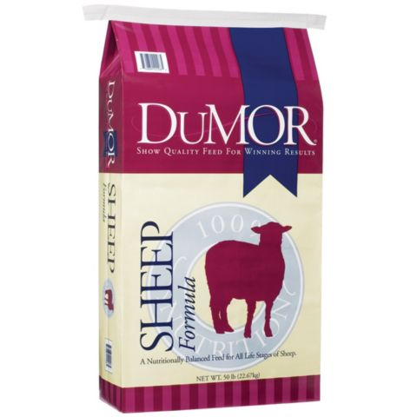
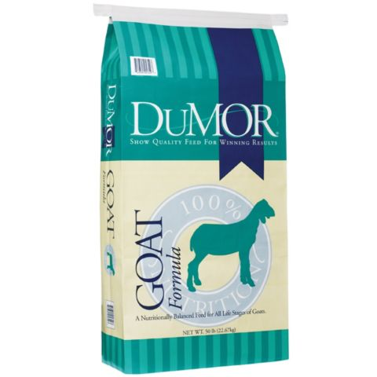
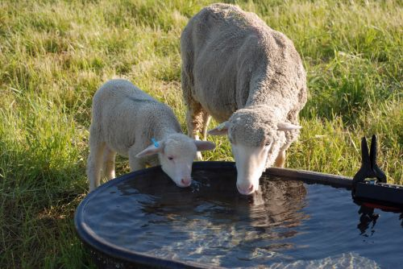
Lamb & Goat Nutrition
Fresh and clean water at all times!
Feed
Don’t feed goat feed to lambs!
GOATS
16-18% protein with at least 10-14% fiber
About 1.5 pounds, 2 times a day (morning & evening)
LAMBS
16-18% protein
Start with ¼ to ½ pound and gradually increase to 2 pounds a day
Feed half in the morning and half in the evening

Slide 4
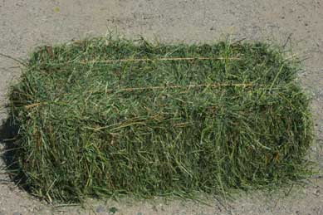
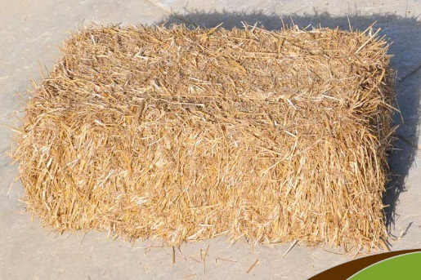
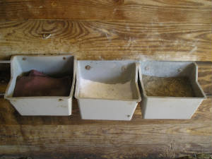
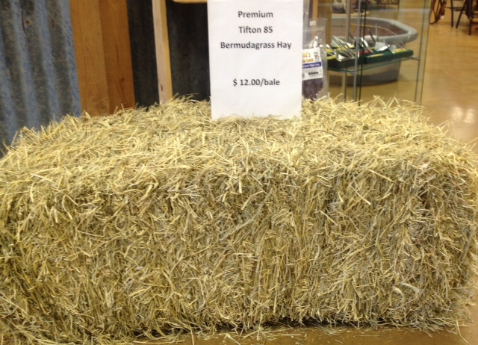
Lamb & Goat Nutrition
Hay (not wheat straw)
Loose salt and minerals (don’t use mineral for cattle, it has a high copper content that will kill lambs)

Slide 5
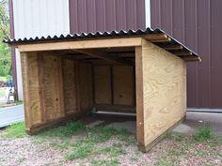
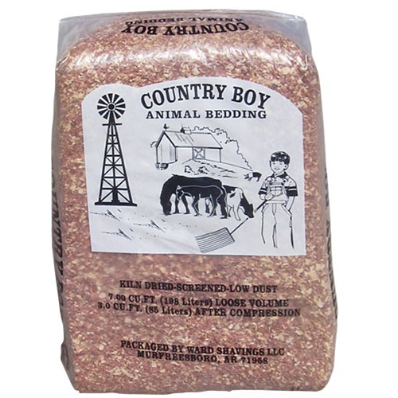
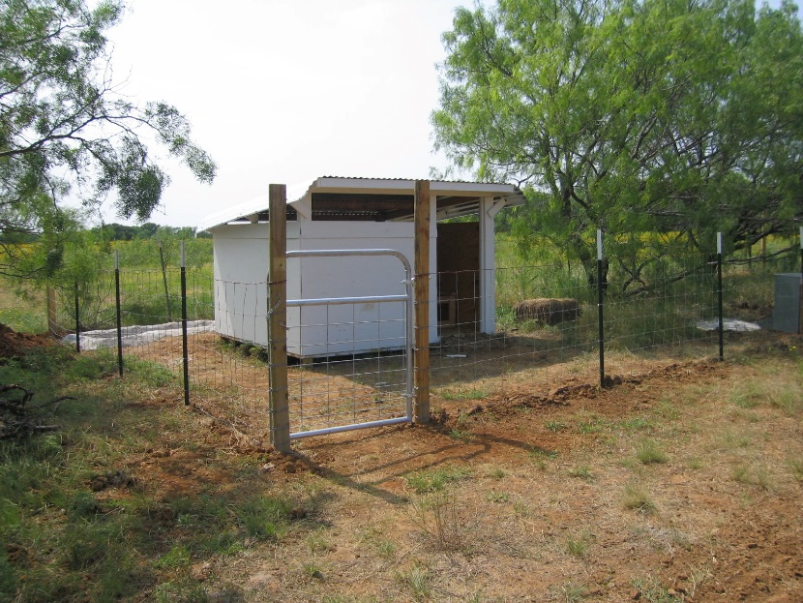
Bedding for Sheep & Goats
Wood shavings or straw
Bedding should be cleaned and replaced weekly
Pen should be clean and dry!

Slide 6
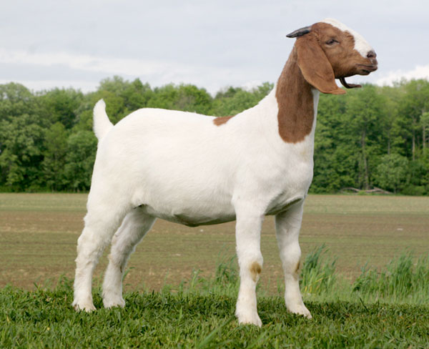
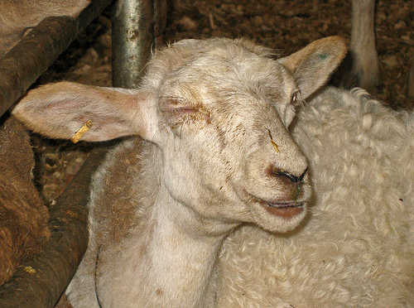
A Healthy Animal
A Sick Animal
Doesn’t eat
Runny nose
Diarrhea
Hair falling out
Runny eyes
Limping
Eats their feed
Has strong legs and feet
Is sociable
Has bright, clear eyes

Slide 7
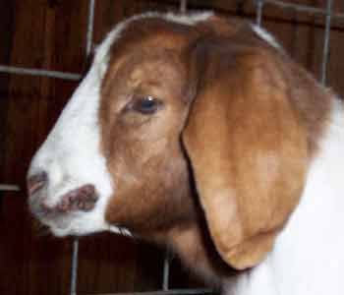
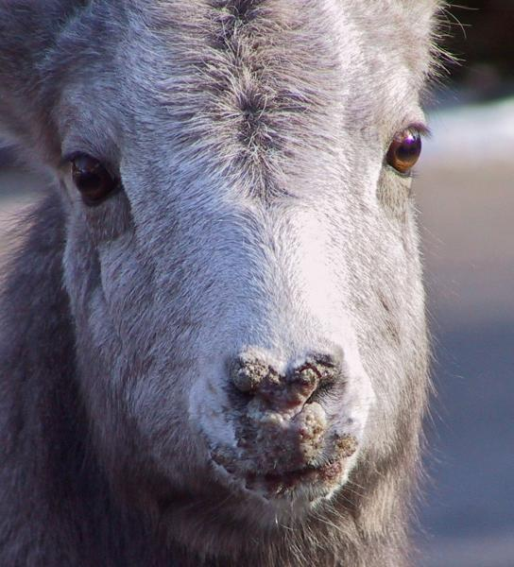
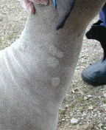
Diseases: Sheep and Goats
Sore mouth – scabs or blisters
Ringworm – circular, thick, flaky lesions
These diseases can be spread to you!

Slide 8
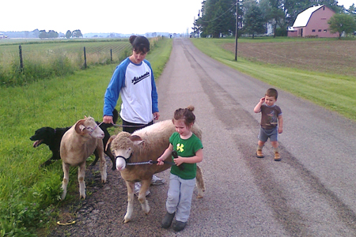
Show Preparation
Spend time with your animal
Practice walking and halter breaking everyday
Be calm and patient with your animal
Make sure your animal is clean (No water in their ears)

Slide 9
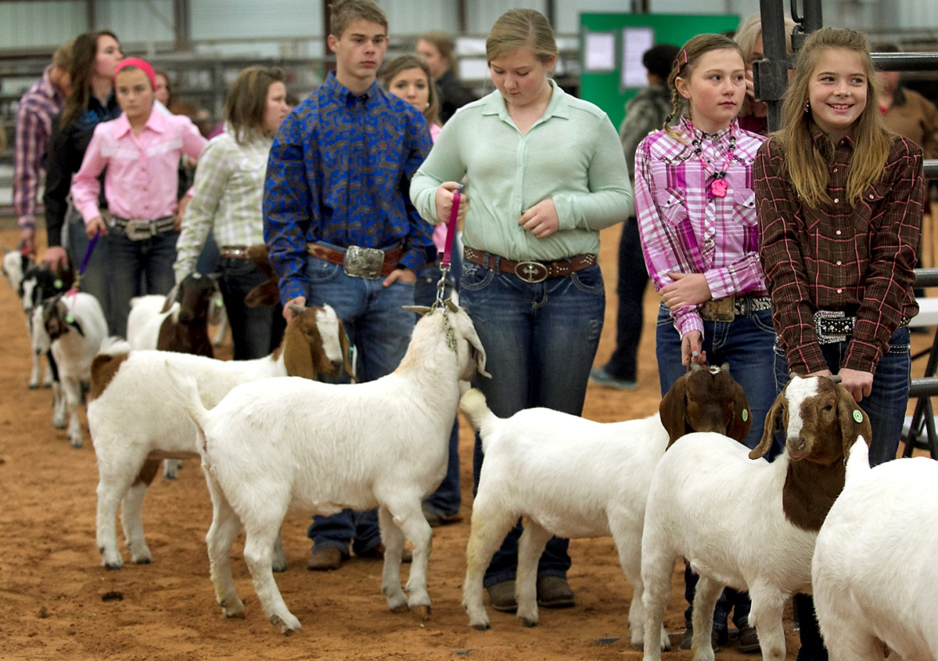
Appropriate Dress
Dress neatly and appropriately
Nice clean boots or shoes that protect your feet (no athletic shoes)
Clean button-front shirts or blouse (shirts should be tucked inside of pants)
Clean dress pants or jeans with a belt
No hats or caps should be worn
Hair should be combed/brushed neatly (braids, clips, ribbons, etc.)

Slide 10
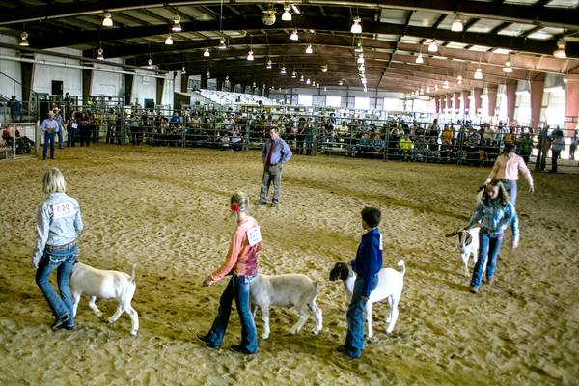
SHOWMANSHIP IN THE RING
Keep your eyes on the judge at all times
Always keep your animal between you and the judge
Remain calm and focused in the ring
Know your animals weight, strength, and weaknesses
Be courteous of other showmen and be a good sport
Never stop showing your animal until you leave the show ring

Slide 11
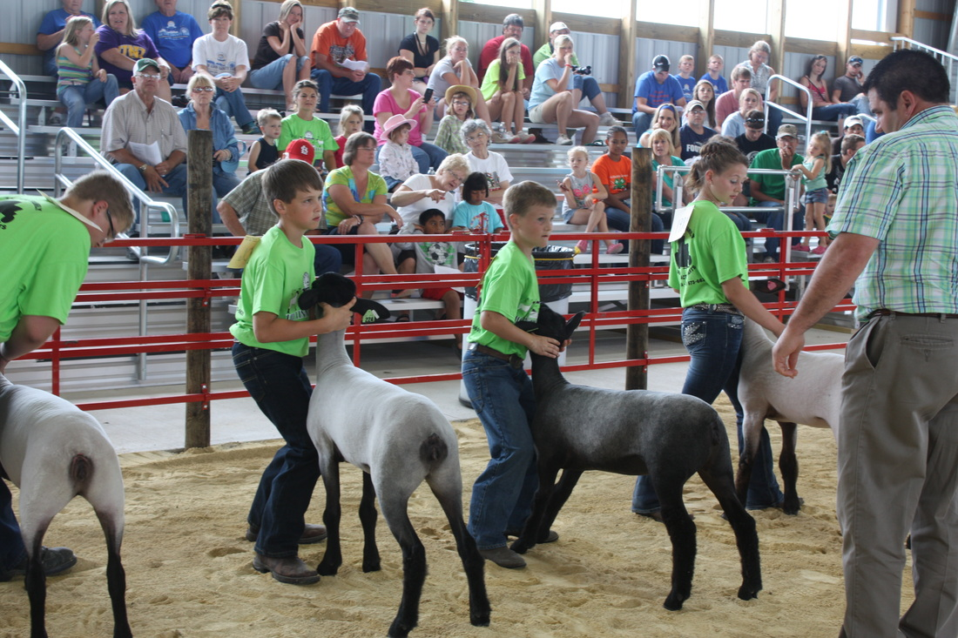
Handling in the Ring
Always make sure the judge has a clear view of your animal
Left hand should be placed under animals muzzle and right hand should be behind the head below the ears
Place your animals legs squarely beneath them with each leg at the four corners of their body
Keep their body parts in a straight line with the head up and ears parallel to the ground
Place your knee and foot in front of the animal

Slide 12
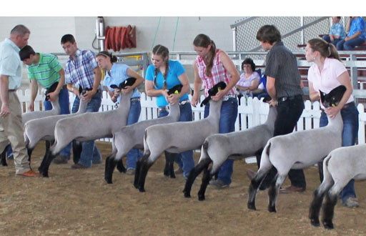
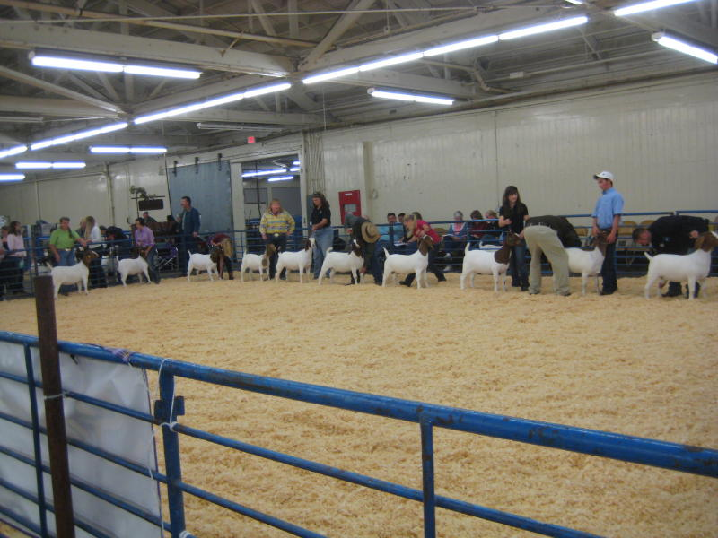
Handling in the Ring (cont’d)
Head-In/Rear-View
Profile/Side-View

Slide 13
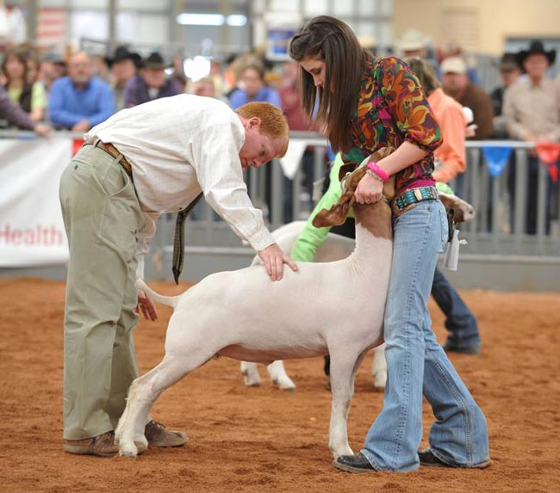
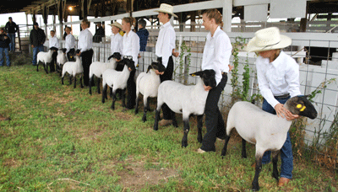
Handling in the Ring (cont’d)
Head-In/Rear-View
Profile/Side-View

Slide 14
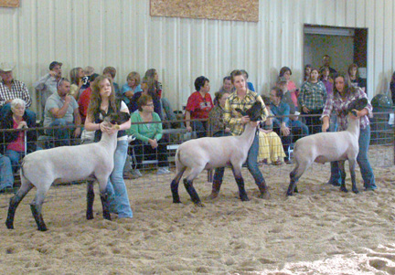
Maneuvering Around The Ring
Always walk behind another showmen animal when being asked to relocate
Do not block a judges’ view of another showmen and their animal
Keep good spacing between you and another showmen
Click on available links for tips…
Livestock Judging Tips
Showmanship Highlights in the Ring

Slide 15
70th Annual Tyrrell County Livestock Show
April 17th, 2019
Have fun, work hard, and good luck!!!

